Slide 1
Python, Pandas and Databases

Slide 2
Outline
Databases vs Flat files
Project Scoping Update
Python
Intro Pair Programming (Pandas)

Slide 3
How Can We Store Data?
File system data files (delimited text and spreadsheets)
Native data files for your statistical package of choice
Database management systems (DBMS)

Slide 4
Excel, Comma-separated values (CSV), tab-delimited, fixed-width
Pros:
Platform independent
Relatively easy to make and use
Fine for small data sets and simple analysis
Cons:
Analysis can be made repeatable, but substantial overhead related to preparing files for analysis
Large files become unwieldy
As analysis and data become more complex, harder to keep track of different files and tie data together

Slide 5
Stata, SAS, R, SPSS
Pros:
Good for modest-sized, relatively simple data sets (often limited by amount of memory)
Data is parsed and ready to analyze
Statistical packages provide some of the features of full-on databases – indexing, filtering, etc.
Cons:
Can be difficult to migrate data from one statistical package to another
As data increases in size and complexity, more difficult to share and collaborate, and statistical package eventually can’t easily keep up

Slide 6
Databases
A database is a collection of data about entities. It can be more or less structured, depending on the type of database, and can include information about the relationships between entities.
A database management system (DBMS) is system that provides infrastructure for storing, managing, and interacting with databases. This includes:
The way the system stores data
A query language, which specifies how users interact with data (SQL)
Add, delete, update, retrieve
There are hundreds of different DBMS, but the two main types are relational(SQL) and non relational (NoSQL)

Slide 7
Relational Databases Are Structured
There are tables and these tables may have dependencies on each other, or relationships
A database for our class projects will have a table for patents and one for inventors. These two tables are related, because a patent is developed by an inventor
Columns represent the data point to be stored and a row represents a record with data points per column that has been defined
These are defined in a table which is usually atomic in nature; this means that a table should really only store data records on one entity or object at a time

Slide 8
One flat file vs Relational Database
InvNo | InvName | UnivNo | UnivName
1 | Camila | 10 | NYU
2 | Bob | 20 | Columbia
3 | Xia | 10 | NYU
4 | Rasheed | 20 | Columbia
5 | Molly | 10 | NYU

Slide 9
UnivNo | UnivName
10 | NYU
20 | Columbia
foreign key
InvNo | InvName | UnivNo
1 | Camila | 10
2 | Bob | 20
3 | Xia | 10
4 | Rasheed | 20
5 | Molly | 10

Slide 10
Definitions
Entity: Something in the real world that is of interest and that you want to store information about, such as our inventors (->Table)
Instance: Each specific inventor is considered an instance of that entity. For example, in Table 3, Doug is an instance of the entity Inventor (->Row)
Attribute: Used to represent information about an entity instance that will be tracked. An example of an attribute might be the address of the inventor (->Column)
primary key: Uniquely identifies a specific instance of an entity. No two instances of an entity can have the same primary key

Slide 11
How to Build a Database
A database is built in two stages
First you create a logical data model to lay out the design of the database and how the data will be organized
Then you implement the database according to the physical data model, which sets up the actual tables and columns
Normalizing: A given piece of information is only stored once, any information that could be applied to an entity more than once gets its own table, rather than a set of columns in a row

Slide 12
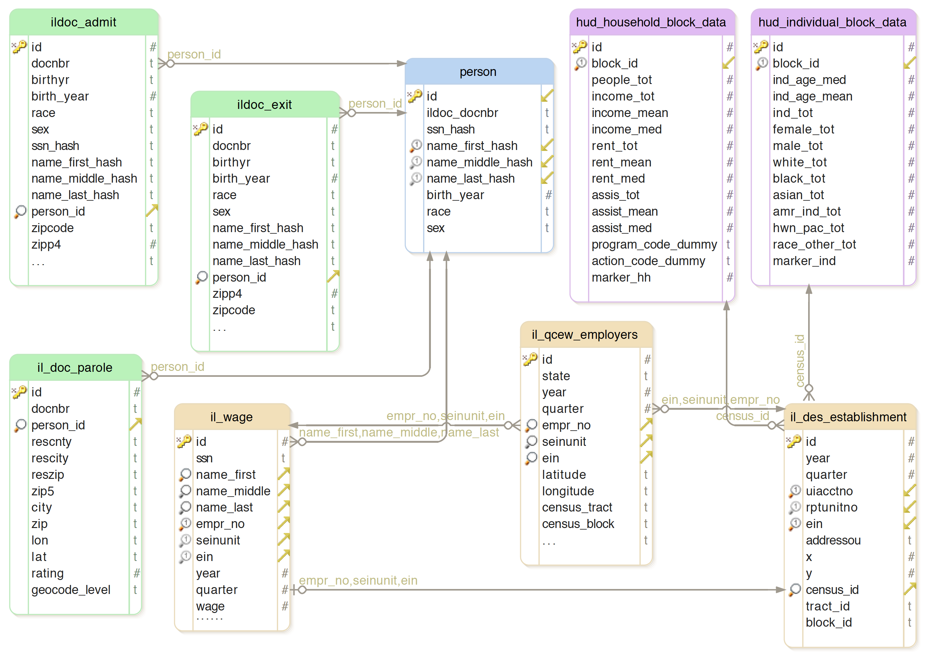

Slide 13
Pros and Cons
Relational DBMS pros:
Well-suited for tabular data
Relations provide good support for normalization
Logical representation of data (tables and rows) separate from how data is stored
Easily integrable - Most programming languages and statistical packages can use SQL to load data from and write to databases
Relational DBMS cons:
Requires initial investment setting up schema and populating tables (data cleaning and loading can be substantial work if data files don’t fit the schema).
Hasn’t always been a good fit for unstructured data (how to define schema?)

Slide 14
Non Relational Database (NoSQL)
NoSQL = a wide variety of databases that relax consitentcy in order to increase scalability and/or availability
NoSQL initially stood for “No SQL”, now stands for “Not Only SQL”
Generally do not require a fixed table schema nor do they support JOINs or other relational database features
Designed to process extremely large amounts of data and handle many concurrent users
NoSQL databases are document-oriented (store unstructured data in a single document)
A patent document, would have the patent’s information, a sub-category for all the inventors on the patent (JSON)

Slide 15
Basic key-value store
Simplest of all NoSQL DB
No records, column types, schema, or query language
The basic data structure is a dictionary or map
You can store a value, such as an integer, string, a JSON structure, or an array, along with a key used to reference that value
Value Daniela Hochfellner is assigned with key deh341

Slide 16
Document-based databases
Document databases maintain sets of key-value pairs within a document
Key can relate to a structured document (JSON)
Still no schema or query language – you are responsible for consistency within documents.
database has the ability to index and filter based on values within document
Example: MongoDB

Slide 17
Graph-based databases
Two types of records – nodes and ties
Each record is a name-value pair store so nodes and ties can have attributes
Have specialized query languages that make relational queries quick (give me all the friends of my friends)

